Slide 1
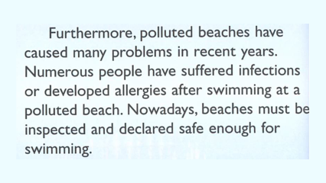
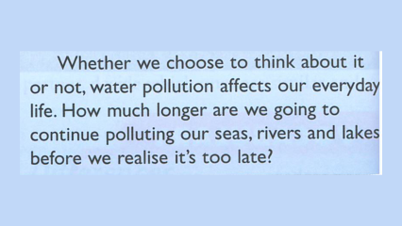
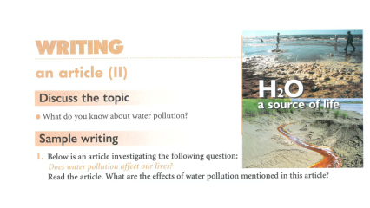
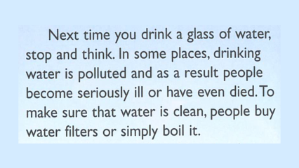
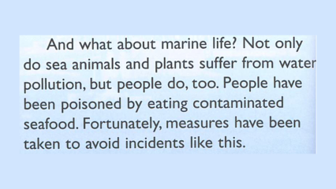
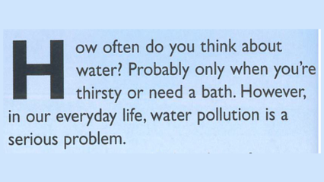
Next

Slide 2
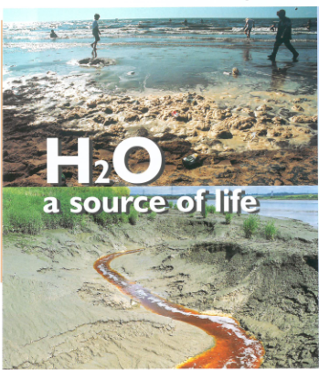
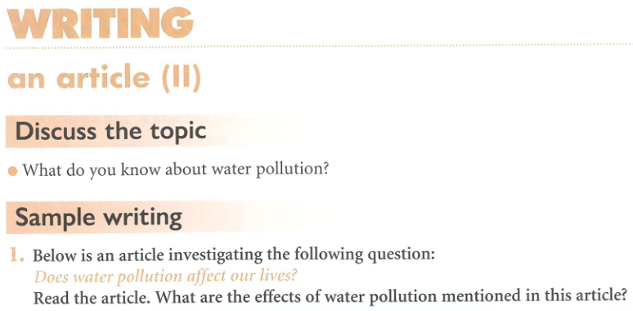

Slide 3
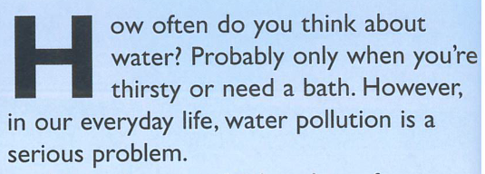

Slide 4
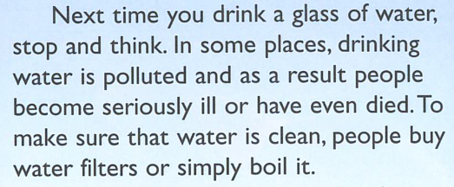

Slide 5
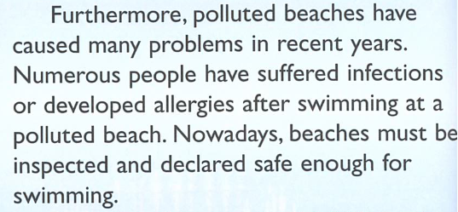

Slide 6
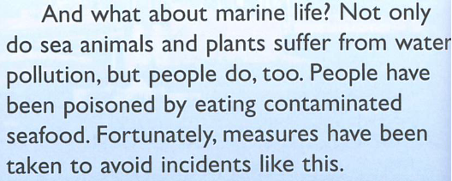

Slide 7
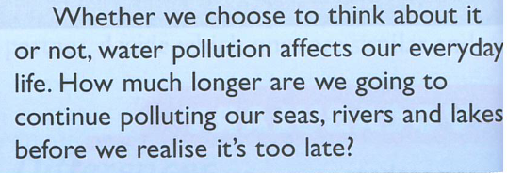

Slide 8
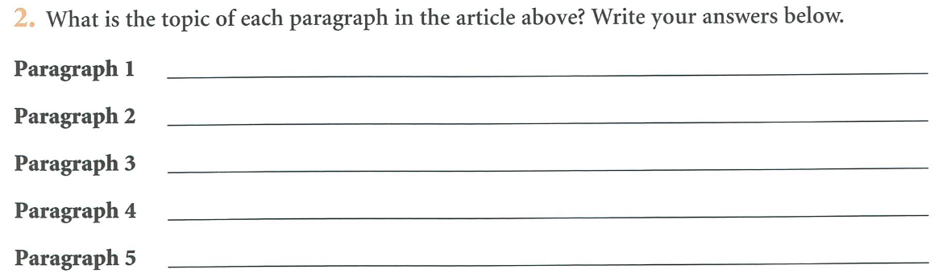
Getting reader to think about water and water pollution.
Health effects of polluted drinking water.
Health effects of polluted sea water and beaches.
Effects of polluted sea water on wildlife and the effects of eating it.
Conclusion and call to action.
Back
Next

Slide 9
Guide to planning
An article is usually written for a newspaper or magazine. This unit deals with articles in which you are asked to state your opinion, make suggestions on a topic or give information about it. Below is a plan for an article of this type, with questions to guide you.

Slide 10
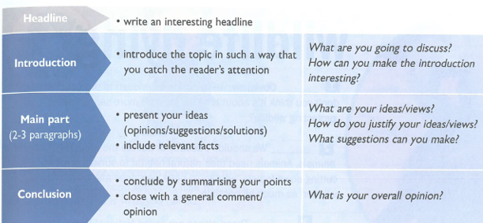
Back
Next

Slide 11
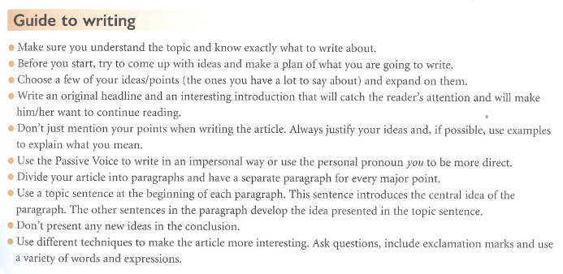
Back
Next

Slide 12
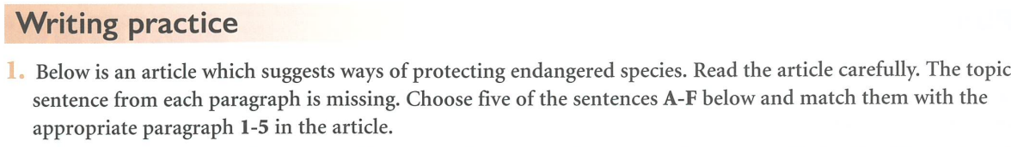

Slide 13
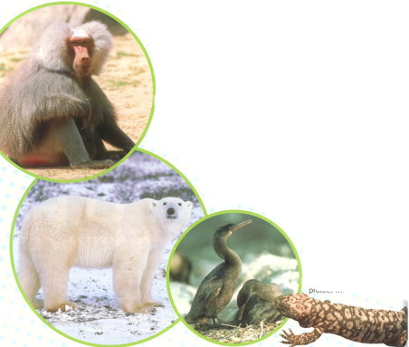


Slide 14

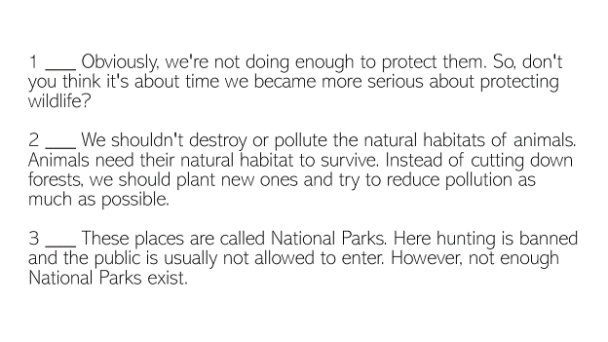
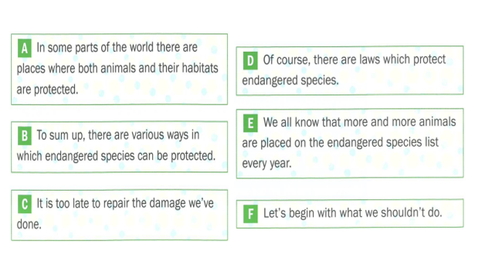
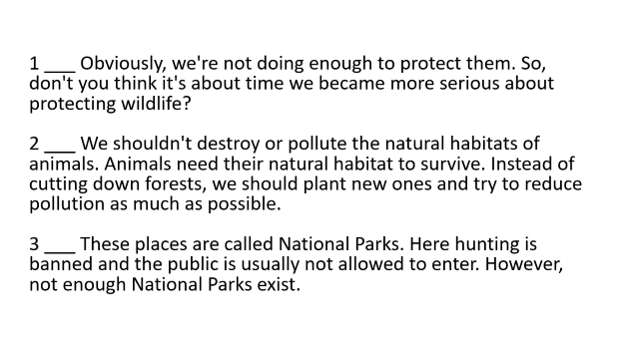

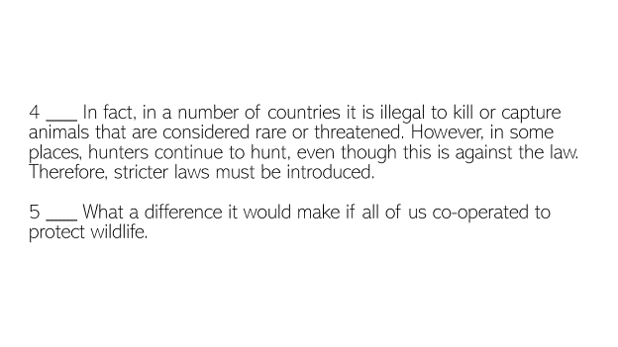
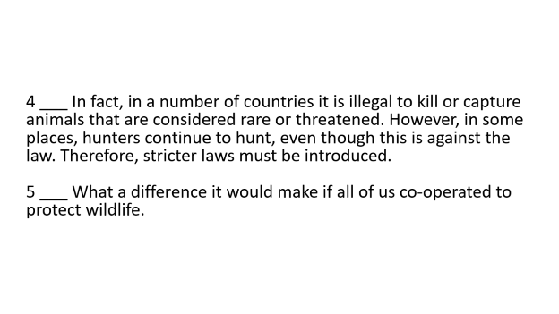
1E 2F 3A 4D 5B

Slide 15
1 ___ Obviously, we're not doing enough to protect them. So, don't you think it's about time we became more serious about protecting wildlife? 2 ___ We shouldn't destroy or pollute the natural habitats of animals. Animals need their natural habitat to survive. Instead of cutting down forests, we should plant new ones and try to reduce pollution as much as possible.
3 ___ These places are called National Parks. Here hunting is banned and the public is usually not allowed to enter. However, not enough National Parks exist.

Slide 16
4 ___ In fact, in a number of countries it is illegal to kill or capture animals that are considered rare or threatened. However, in some places, hunters continue to hunt, even though this is against the law. Therefore, stricter laws must be introduced.
5 ___ What a difference it would make if all of us co-operated to protect wildlife.

Slide 17
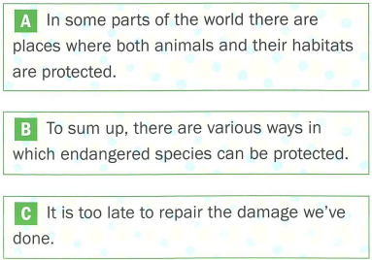
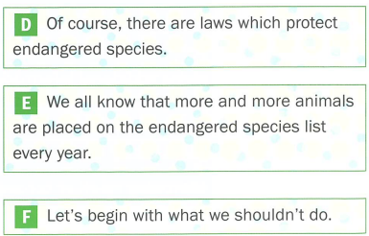

Slide 18
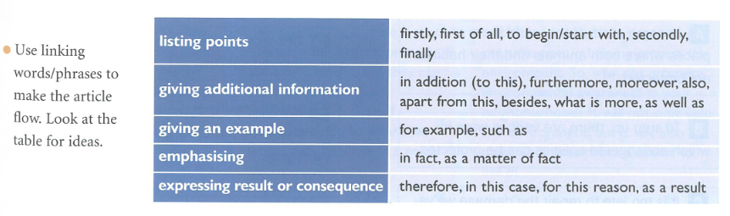
Back
Next

Slide 19
Addendum
The article on water provoked quite some discussion in class. Some of the class felt it could have gone in a different direction and talked about water conservation. With this in mind, here are a few vocabulary items and local knowledge to do with just that.
Back
Next

Slide 20
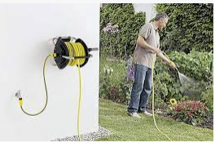
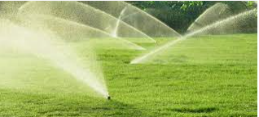
Hosepipe
Sprinkler
The UK often has hosepipe and sprinkler bans to conserve water.
Back
Next

Slide 21
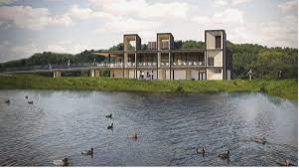
Reservoir a place where water is stored.
Llanishen reservoir, Cardiff
Back

Slide 22
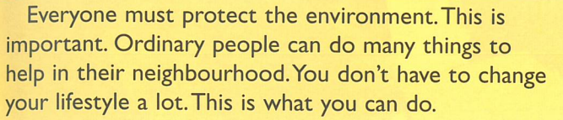
How often do you think about protecting the environment? You may not think it's important, but it is. Caring for the environment is part of everyday life, and ordinary people can make a real difference through simple actions in their own communities. This is what you can do.

Slide 23
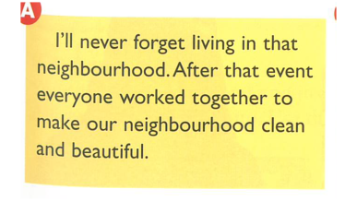
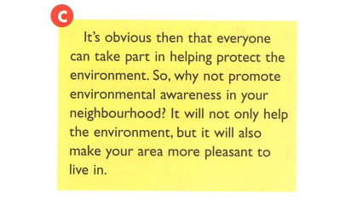
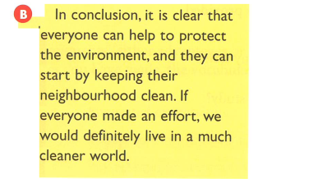

Slide 27
Here is a sample answer. Note that the green indicates the topic sentence, the brown the supporting sentences and the red the concluding sentence of each paragraph.

Slide 28
b. Make a plan for the main part of the article above. Then write the paragraphs of the main part in the space provided.
To begin with, protecting the environment often starts at home. By changing small daily habits, people can already make a real difference. For example, using less water, turning off lights, and recycling waste all help reduce damage to the planet. These actions may seem small, but together they have a strong effect.
At the same time, the way people move around also matters. Instead of using a car for every journey, people can walk, cycle, or use public transport. As a result, there is less pollution in the air and streets become cleaner and quieter. This helps create a healthier place for everyone.
Beyond this, caring for the environment can bring people together. When neighbours clean local areas or share ideas about protecting nature, they help their community as well as the planet. In this way, environmental action becomes part of everyday life and leads naturally to positive change.

Slide 29
3. Task for homework. Your college newspaper has invited you to write an article suggesting ways in which different types of pollution can be reduced in your town/city. Write your article. (120–180 words)

